Slide 1
Machine Learning Algorithms (III-III)
Master´s in Applied Artificial Intelligence
Luís Ferreira
lufer@ipca.pt

Slide 2
Overview
Part I
Artificial Intelligence and Machine Learning
Foundations
Part II
Machine Learning
Part III
Machine Learning Algorithms
Parte IV
Deep Learning & Neural Networks
Parte V
Building a ML Model

Slide 3
Part III
Machine Learning Algorithms
Competencies to be acquired:
ML Model creation
Data Correlation

Slide 4
Part III: MLA
Modelling (Review)
Remember the essential steps:
  Training a model
  Tuning the model:
    Hyperparameter tuning; Experiment Evaluation
  Testing and Comparing results

Slide 5


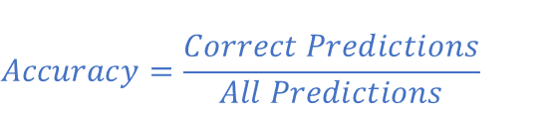
Part III - MLA
Modelling Evaluation (Review)
Evaluation Metrics
$$Accuracy=\frac{Correct Predictions}{All Predictions}$$
$$Precision=\frac{tp}{tp+fp}$$
$$Recall=\frac{tp}{tp+fn}$$
Notes:
Precision k : Example: Top10 (k=10)

Slide 6
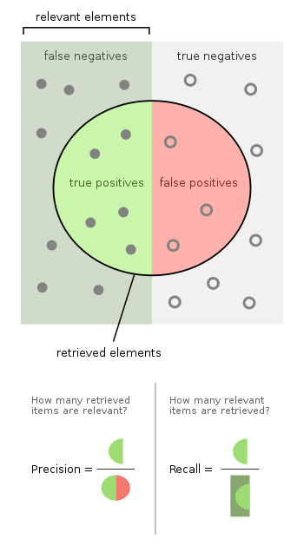
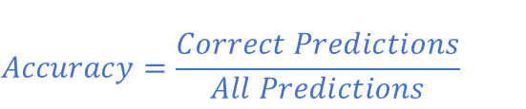


Part III - MLA
Modelling Evaluation (Review)
Evaluation Metrics
$$Accuracy=\frac{Correct Predictions}{All Predictions}$$
$$Precision=\frac{tp}{tp+fp}$$
$$Recall=\frac{tp}{tp+fn}$$
Notes:
Precision k : Example: Top10 (k=10)

Slide 7
Part III - MLA
Modelling Evaluation
Correlation
  Relation among two variables (x,y), i.e, the mutual relationship, covariation, or association between two or more variables!
  It is concerned with the measurement of simultaneous variations in both variables!
  It is not Causation!!!!
Notes:
Precision k : Example: Top10 (k=10)

Slide 8
Part III - MLA
Modelling Evaluation
Correlation
  Relation among two variables (x,y), i.e, the mutual relationship, covariation, or association between two or more variables!
  It is concerned with the measurement of simultaneous variations in both variables!
  It is not Causation!!!!
The fur colour of the cubs and the father wolf are correlated. But it can't be said that the father's colour is caused by the determination only by the colour of his son's fur.
Notes:
Causation == Causalidade
Não podemos afirmar que isso acontecerá para todos os casos

Slide 9
Part III - MLA
Modelling Evaluation
Correlation
  Positive: if both variables increase or decrease
    variable X increases and another variable Y also increases in a similar way
  Negative: variables are inversely proportional
    If one decreases and the other increases
Notes:
Precision k : Example: Top10 (k=10)

Slide 10
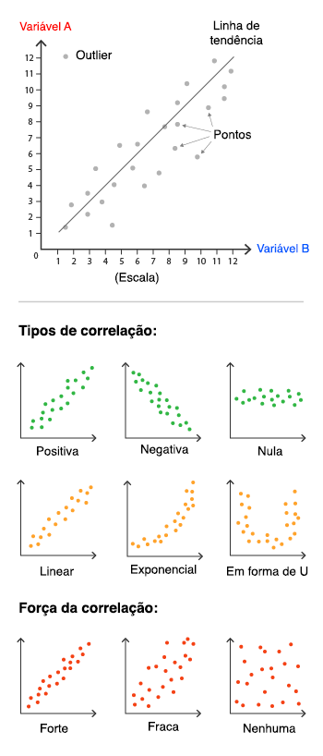
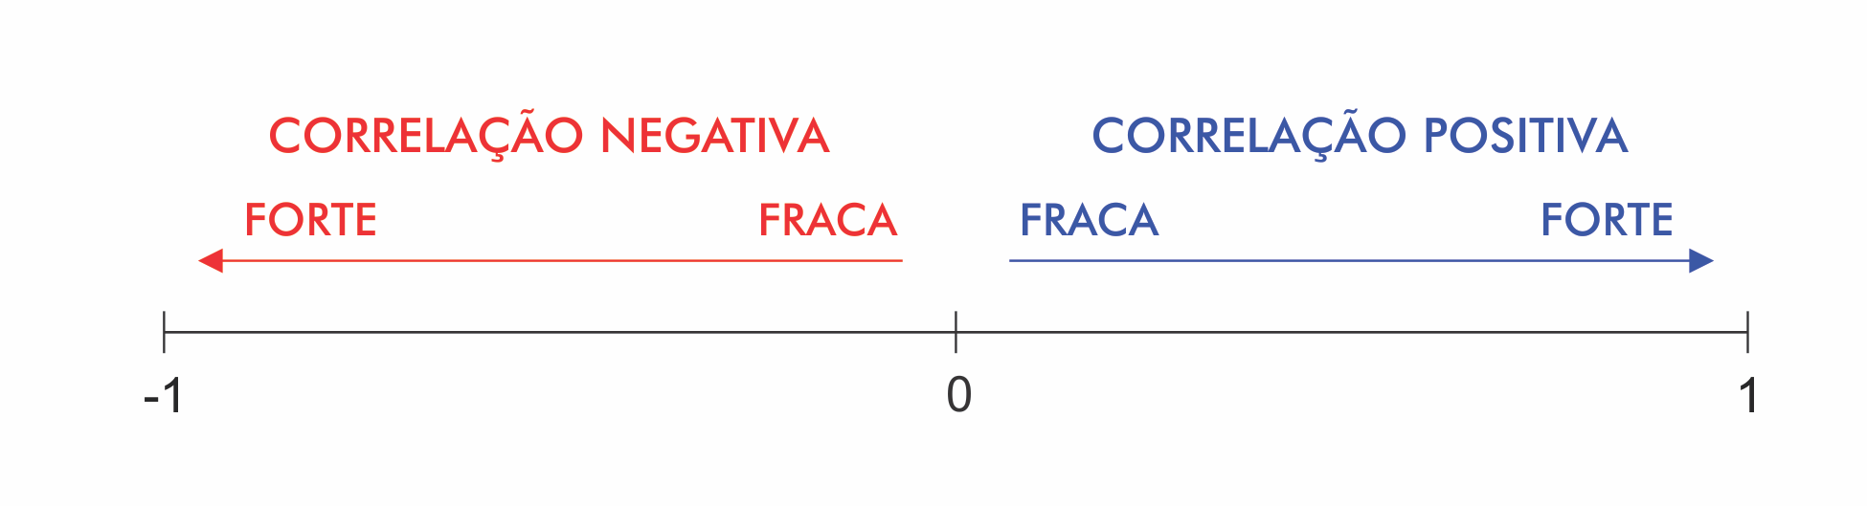
Part III - MLA
Modelling Evaluation
Correlation
  Positive: if both variables increase or decrease
    variable X increases and another variable Y also increases in a similar way
  Negative: variables are inversely proportional
    If one decreases and the other increases
Notes:
Precision k : Example: Top10 (k=10)

Slide 11
Part III - MLA
Modelling Evaluation
Correlation
  Linear
  U-Form
  Exponential
Notes:
https://escoladedados.org/tutoriais/correlacao-nao-e-causalidade-mas-o-que-e-entao/

Slide 12
Part III - MLA
Modelling Evaluation
Correlation in Machine Learning
  Metrics:
    Pearson’s correlation of coefficient (r) (+1 to -1) quantitative variables
    Spearman’s correlation of coefficient rho (ρ) (+1 to -1) quantitative | qualitative
    Kendall’s Tau correlation of coefficient tau (τ) (‘+1 to -1) ordinal
  Important to select the most relevant features!
  Data having non-correlated features have many benefits
Notes:
https://statplace.com.br/blog/coeficientes-de-correlacao/

Slide 13
Part III - MLA
Modelling Evaluation
Correlation in Machine Learning
  Metrics:
    Pearson’s correlation of coefficient (r) (+1 to -1) quantitative variables
    Spearman’s correlation of coefficient rho (ρ) (+1 to -1) quantitative | qualitative
    Kendall’s Tau correlation of coefficient tau (τ) (‘+1 to -1) ordinal
  Important to select the most relevant features!
  Data having non-correlated features have many benefits
Data having non-correlated features have many benefits:
  1. Learning of Algorithm will be faster
  2. Interpretability will be high
  3. Bias will be less
Notes:
https://statplace.com.br/blog/coeficientes-de-correlacao/

Slide 14
Part III - MLA
Modelling Evaluation
Variables can be classified as follows:
Quantitative Variables: these are characteristics that can be measured on a quantitative scale, i.e. they have numerical values that make sense. They can be continuous or discrete.
  Discrete variables: measurable characteristics that can only take on a finite or infinite countable number of values and therefore only integer values make sense. They are usually the result of counting. Examples: number of children, number of bacteria per litre of milk, number of cigarettes smoked per day.
  Continuous variables, measurable characteristics that take on values on a continuous scale (on the real line), for which fractional values make sense. They usually have to be measured using an instrument. Examples: weight (scale), height (ruler), time (clock), blood pressure, age.
Qualitative (or categorical) variables: these are characteristics that do not have quantitative values, but instead are defined by various categories, i.e. they represent a classification of individuals. They can be nominal or ordinal.
  Nominal variables: there is no ordering among the categories. Examples: sex, eye colour, smoker/non-smoker, sick/sad.
  Ordinal variables: there is an ordering between the categories. Examples: schooling (1st, 2nd, 3rd grade), stage of illness (initial, intermediate, terminal), month of observation (January, February,..., December).
Correlation in Machine Learning
  Metrics:
    Pearson’s correlation of coefficient (r) (+1 to -1) quantitative variables
    Spearman’s correlation of coefficient rho (ρ) (+1 to -1)
    Kendall’s Tau correlation of coefficient tau (τ) (‘+1 to -1)
  Important to select the most relevant features!
  Data having non-correlated features have many benefits
Notes:
https://statplace.com.br/blog/coeficientes-de-correlacao/

Slide 15
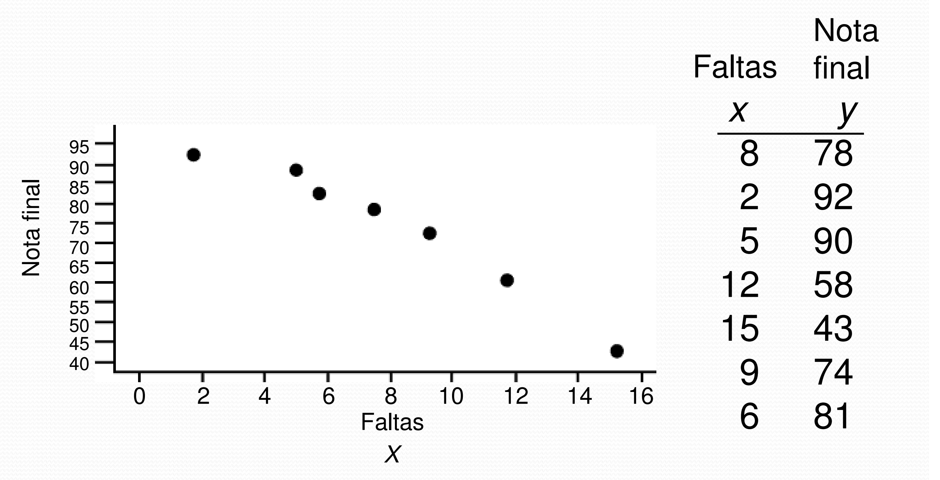
Part III - MLA
Modelling Evaluation
Is there any correlation?
r = ?
ρ = ?
Exercise: Calculate in Pandas?
Correlation
  Positive: if both variables increases
    variable X increases and another variable Y also increases in a similar way
  Negative: if both variables decreases
    If one decreases along with the other
Notes:
https://statplace.com.br/blog/coeficientes-de-correlacao/

Slide 16
Part III - MLA
Explore
Data Correlation
  Jupyter Notebook
  4_Data_Manipulation_Modelling_II.ipynb
Notes:
https://statplace.com.br/blog/coeficientes-de-correlacao/

Slide 17
Progress
Part I
Artificial Intelligence and Machine Learning
Foundations
Part II
Machine Learning
Part III
Machine Learning Algorithms (I)
Part IV
Machine Learning Algorithms (I)
Part V
Deep Learning & Neural Networks

Slide 18
References
The Lifecycle of an AI
  https://labelyourdata.com/articles/lifecycle-of-an-ai-project-stages-breakdown#step_4_scrub_your_data_clean
Examples of Machine Learning Projects
  https://www.datacamp.com/blog/machine-learning-projects-for-all-levels
Elements of AI (free online course)
  https://www.elementsofai.com/

Slide 19
References
Google Colab
  https://colab.research.google.com/
Pandas Tutorial
  https://www.w3schools.com/python/pandas/ref_df_sample.asp

Slide 20
References
Machine Learning. Tom M. Mitchel, McGraw-Hill, 1997
Machine Learning for Everyone
  https://vas3k.com/blog/machine_learning/
Machine Learning Tutorial
  https://www.simplilearn.com/tutorials/machine-learning-tutorial/machine-learning-steps
What is machine learning and how does it work? In-depth guide
  https://www.techtarget.com/searchenterpriseai/definition/machine-learning-ML

Slide 21
Appendices

Slide 22
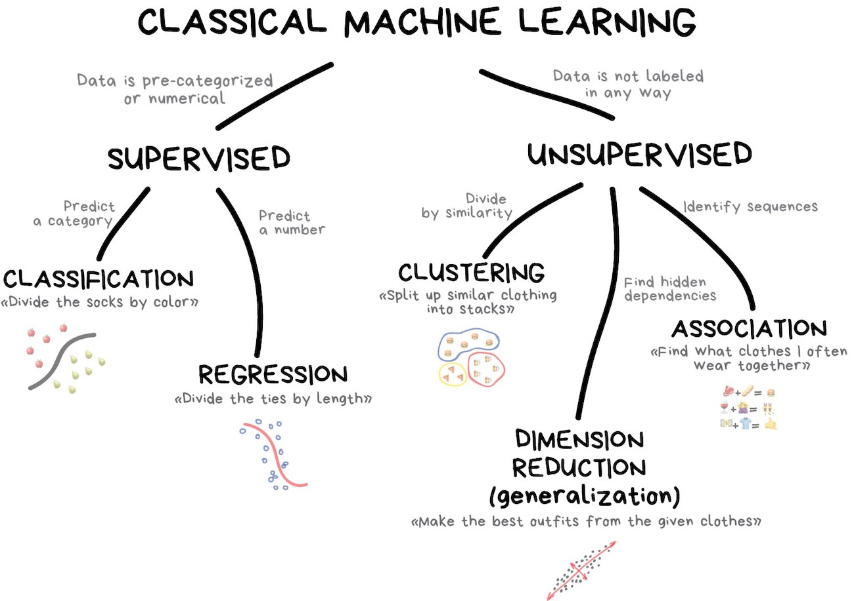
Notes:
https://vas3k.com/blog/machine_learning/

